Slide 1

IAM (ManageSmart)
DECEMBER 2022

Slide 2

Content
1
About ManageSmart
2
ManageSmart Dashboards
3
Onboard Employees
4
Device Performance Analytics
5
Productivity Tracker

Slide 3
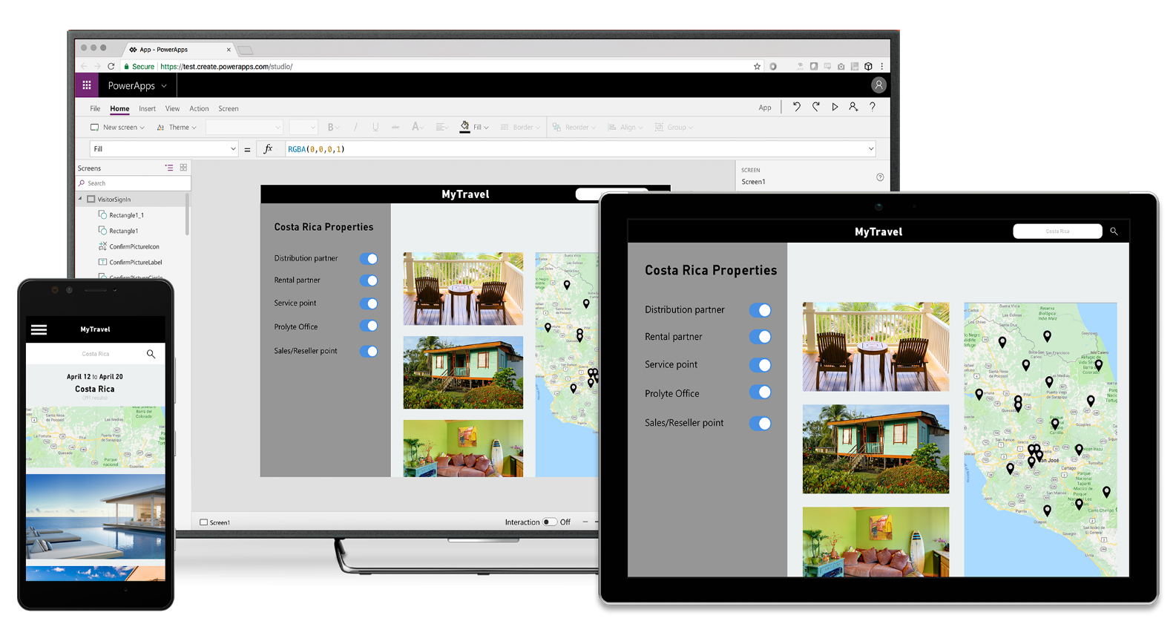
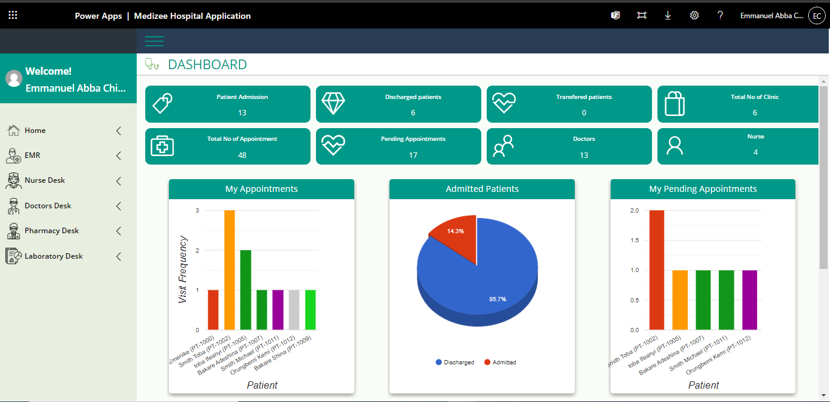
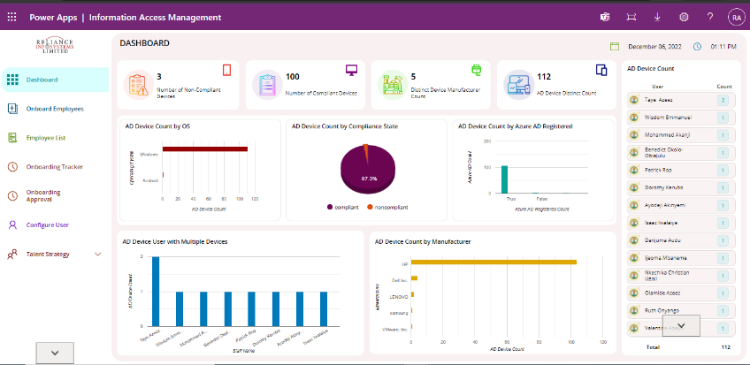


About ManageSmart
The Information Access Management (ManageSmart) is a smart Device Management tool for productivity ramp-up and also to expedite staff onboarding.
It leverages information it extracts from all organizational-given devices as a means to the end of monitoring and increasing productivity.
It also retrieves information on device usage and management by individual employees.
The ManageSmart ensures that all devices issued out to employees are adequately accounted for, monitored, and rightly utilized. It also informs on the usage of the devices by the last logged-in time retrieval. New employees can be onboarded and configured instantly into the organizational Office 365 tenant. It also gives room for disengaging office 365 accounts of former employees.
A survey in 2014 by salary.com revealed that 89% of workers admitted to wasting time at work every day.
Also, onboarding employees take too much time for creating accounts, and assigning tools and sometimes there are omissions

Slide 4
Why ManageSmart?
Eliminate drudgery experienced during onboarding through automation and ensure employee hits the ground running
EFFICIENT ONBOARDING
Benefits
Increase device accountability, and visibility; and track performance of all devices.
DEVICE ACCOUNTABILITY
Increase staff productivity by proactively resolving issues around their devices and tracking their engagement with their work tools.
BOOST PRODUCTIVITY

Slide 5
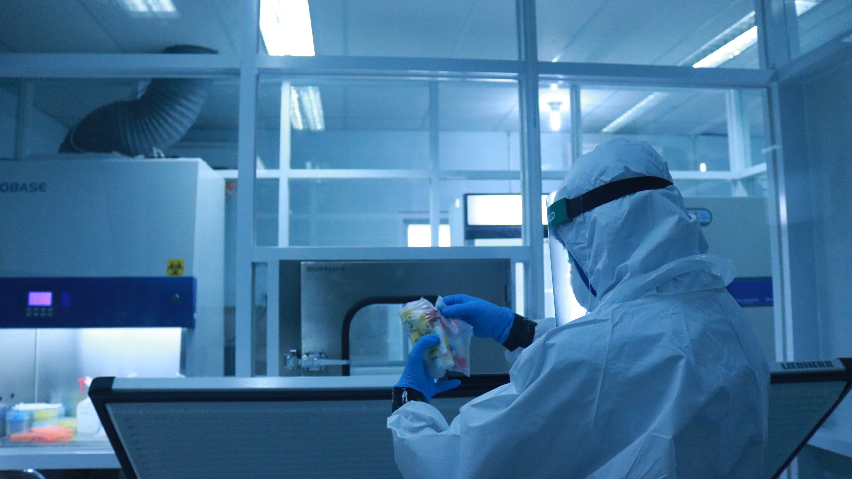

Rich Dashboard
A detailed dashboard that summarizes activities for all organization devices
Benefits
Insight into all compliant and non-compliant devices
Overview of all devices across their OS
Summary of assigned devices and details

Slide 6

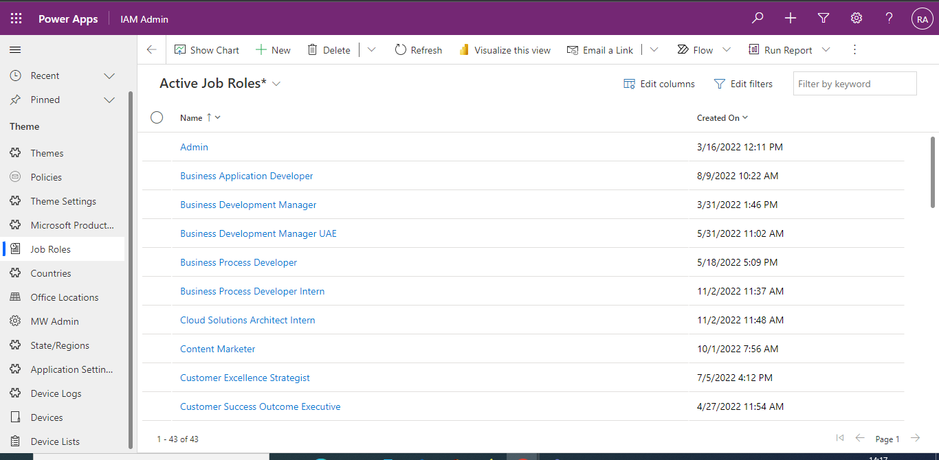
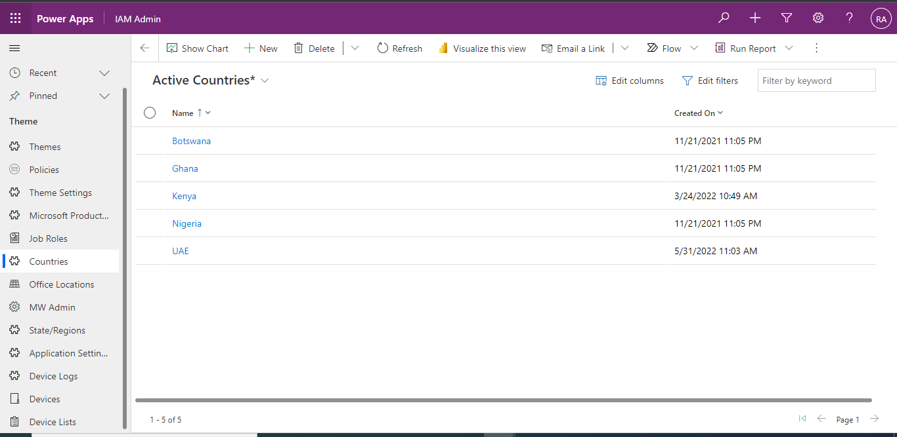
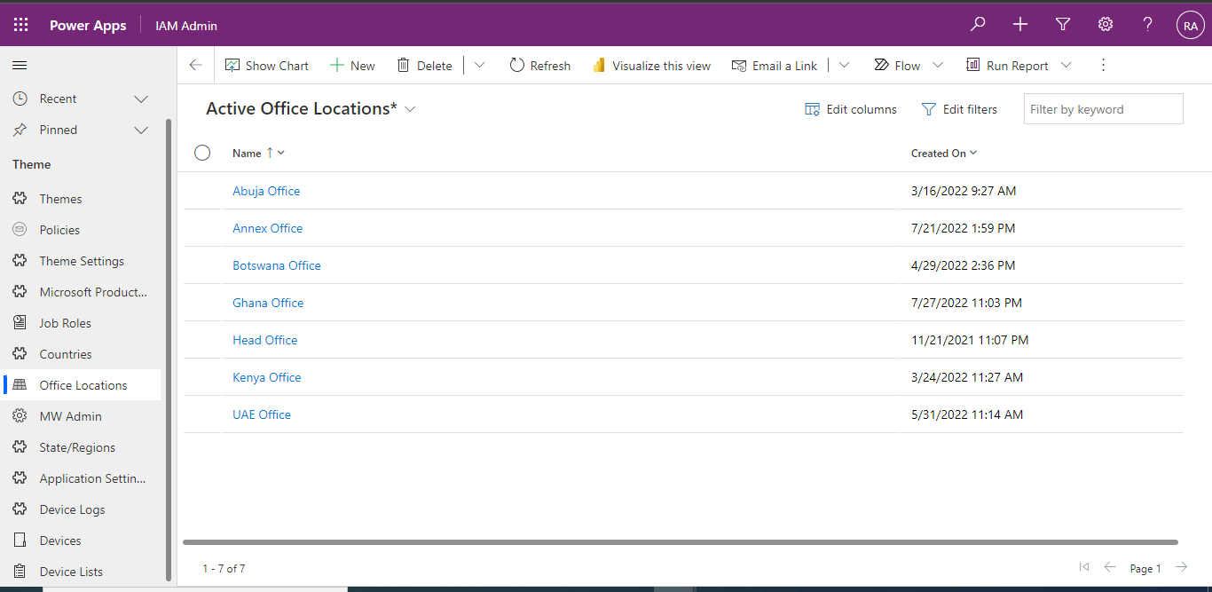
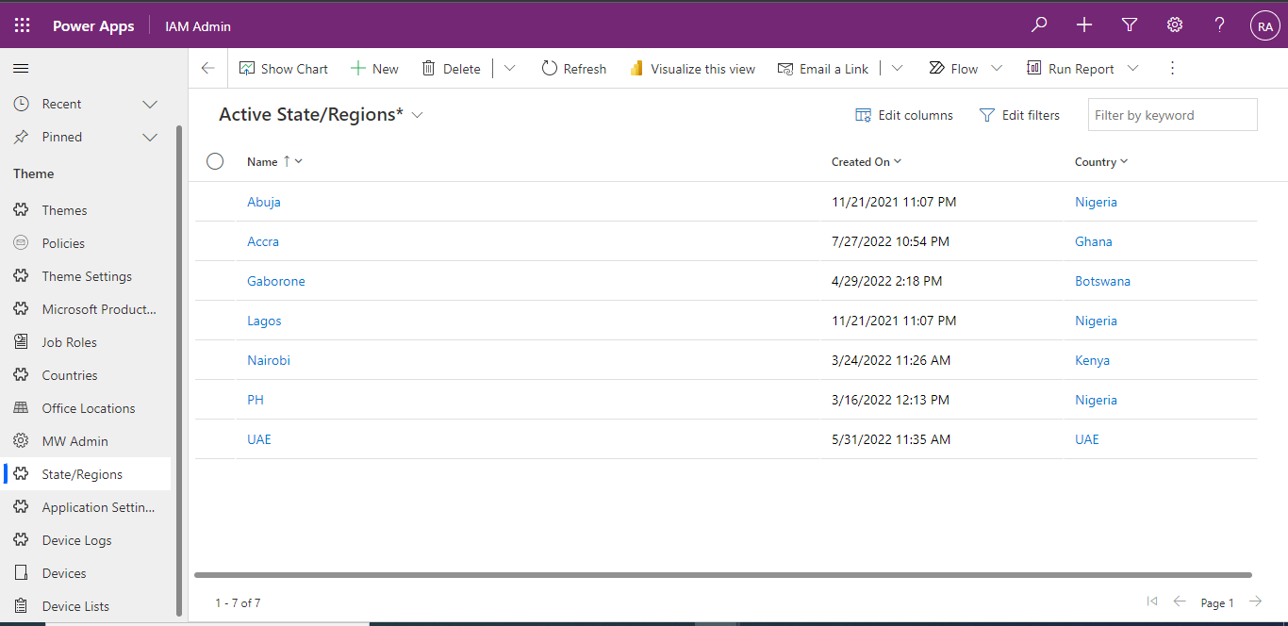
A Super Admin View
Admin can view all employee onboarding details.
Benefits
View all job roles in the organization.
View and configure all company’s locations and footprint.

Slide 7
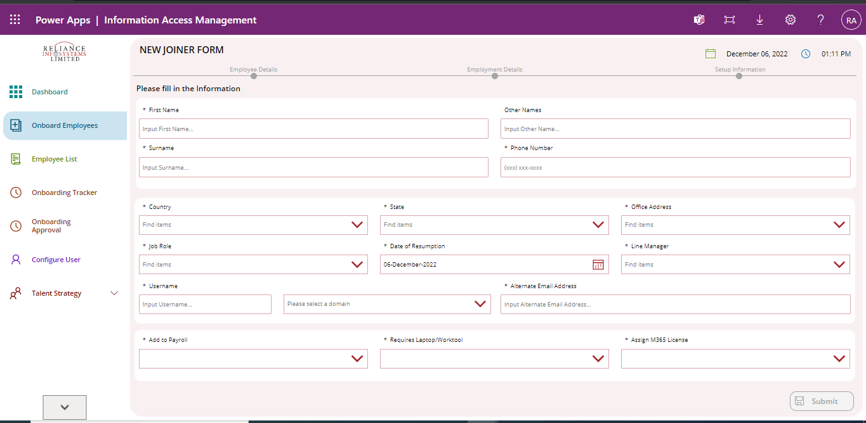
ONBOARD EMPLOYEES
New employees can be onboarded and configured instantly into the organizational Office 365 tenant.
Benefits
Shorter onboarding turnaround time.
Automated onboarding eliminates drudgery and errors
Quick provisioning of licensing, access, and work tools required for the employee’s delivery.

Slide 8

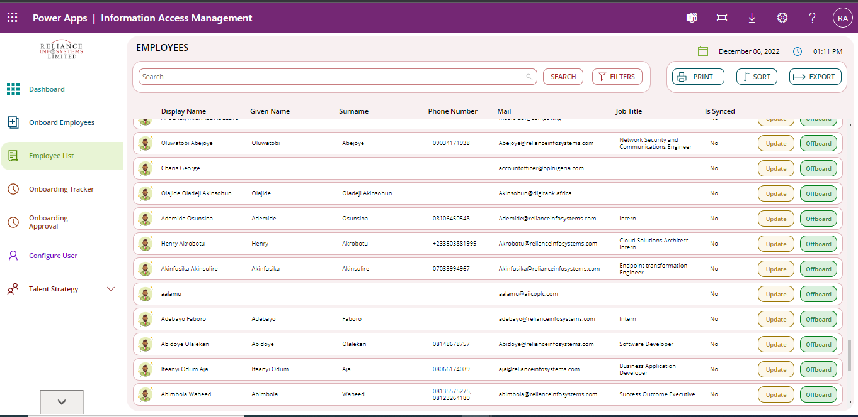
All Doctors
Employee List
View staff directory
Staff directory is accessible to view roles and every other employment detail.
Admin can quickly control access of each employee to the company’s software solutions and licenses. It is easy and quick to restrict a perceived threat from the system
Benefits
Evaluate all tasks assigned to help desk agents to implement load balancing
View all tickets that there are in the system to check for trends and patterns
Track all incidents by departments to know when to trigger alternative resolution means.

Slide 9
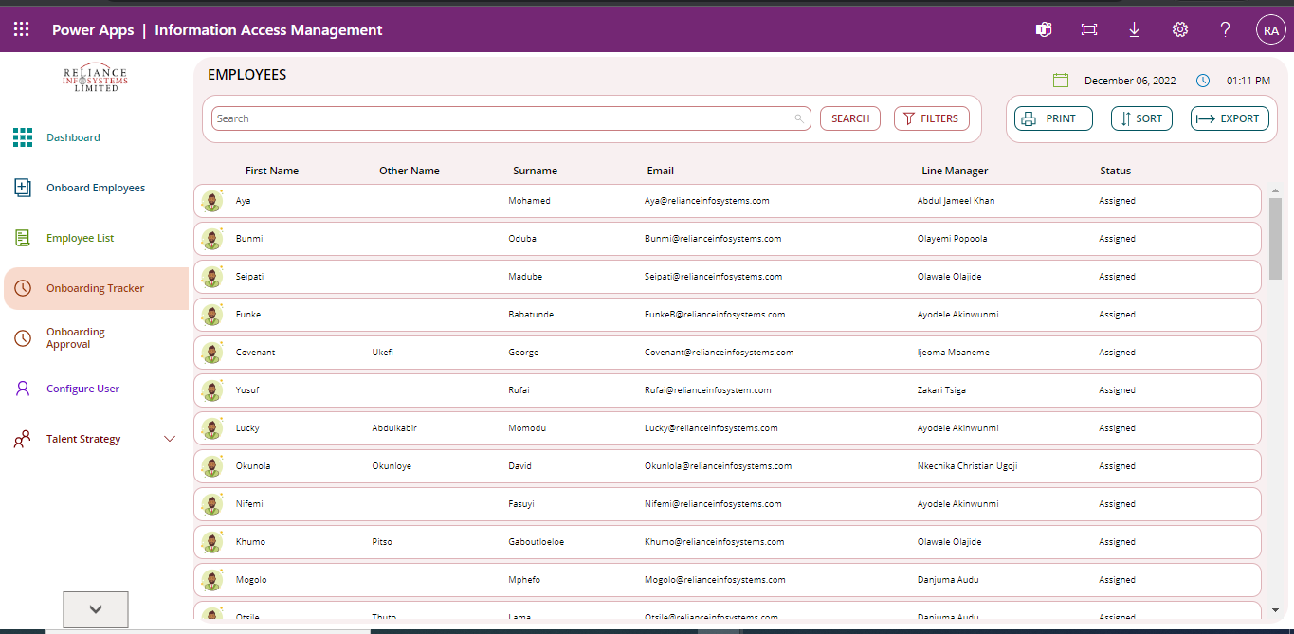
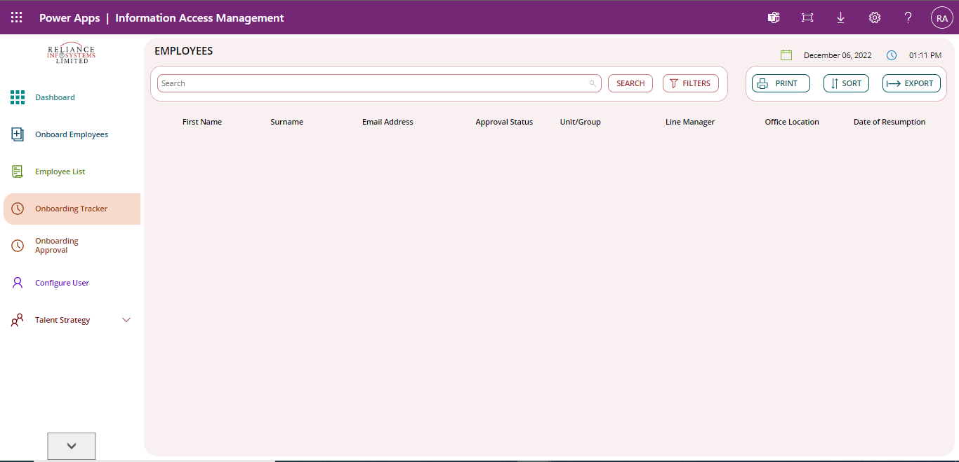
Onboarding Tracker/ Approval
All Doctors
Gerald
Geoffrey
Fred
Fred.g@lkcog.com
Loveth Smilemore
The entire onboarding process is tracked to eliminate bottlenecks.
Line managers are automatically alerted of employees that report to them
Benefits
Evaluate all tasks assigned to help desk agents to implement load balancing
View all tickets that there are in the system to check for trends and patterns
Track all incidents by departments to know when to trigger alternative resolution means.

Slide 10
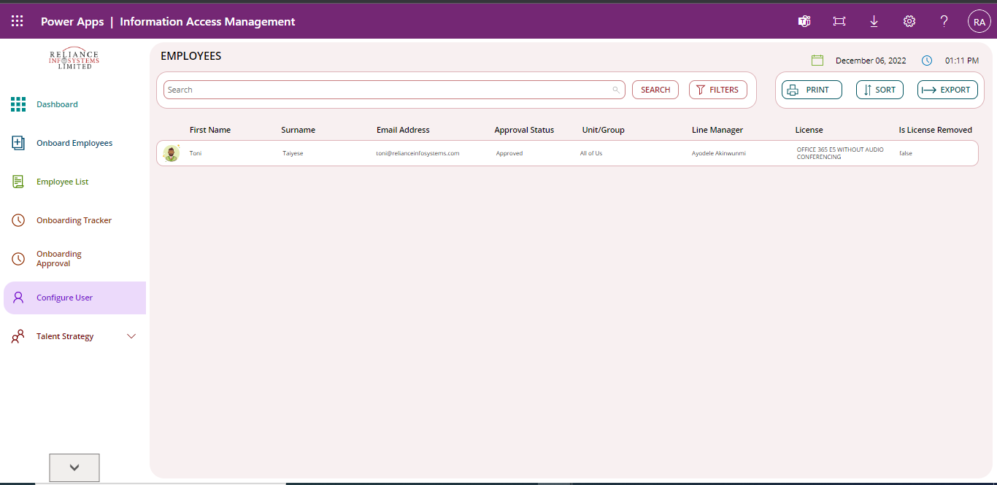
All Doctors
Configure User
Admin can control license type provisioned for each employee and scale up when required in line with the department and job role of such employee
Benefits
Evaluate all tasks assigned to help desk agents to implement load balancing
View all tickets that there are in the system to check for trends and patterns
Track all incidents by departments to know when to trigger alternative resolution means.

Slide 11
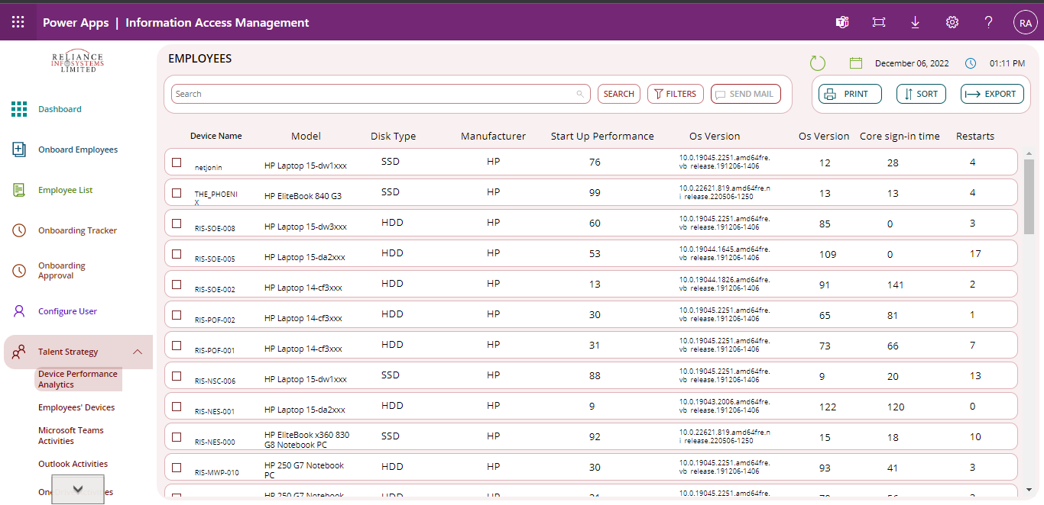
All Doctors
Device Performance Analytics
View staff devices
View all staff devices and their categorization
Devices can be tracked for performance; providing information like restarts, sign-in, and more.
Device information can be leveraged to detect endangered devices for proactive actions
Benefits
Evaluate all tasks assigned to help desk agents to implement load balancing
View all tickets that there are in the system to check for trends and patterns
Track all incidents by departments to know when to trigger alternative resolution means.

Slide 12
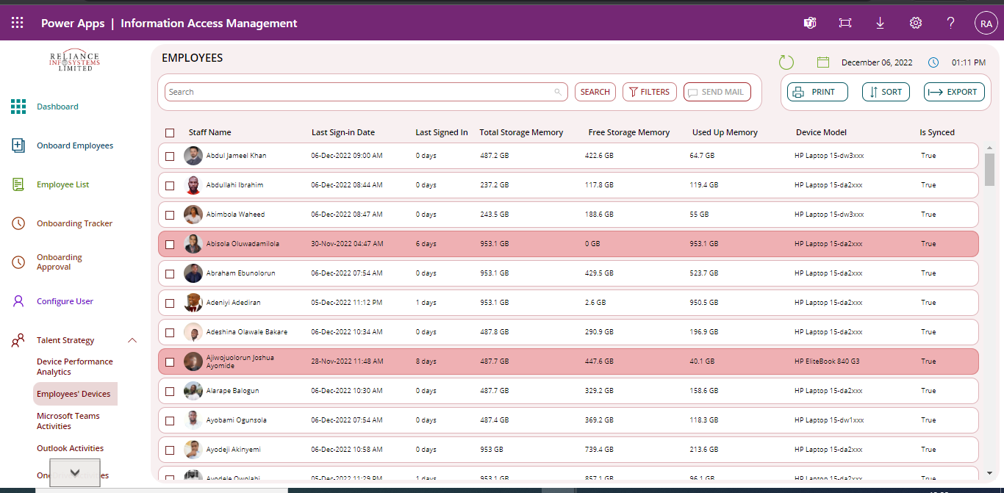
All Doctors
Employee Devices
Track employee usage of their device by checking last sign-in dates.
Automated emails to employees that fail to sign in to their devices for a specified period of time. This also helps to track device theft.
Track device storage memory usage to ensure employees are not overburdening device
Benefits
Evaluate all tasks assigned to help desk agents to implement load balancing
View all tickets that there are in the system to check for trends and patterns
Track all incidents by departments to know when to trigger alternative resolution means.
Peculiar Olugbola
James Smart

Slide 13
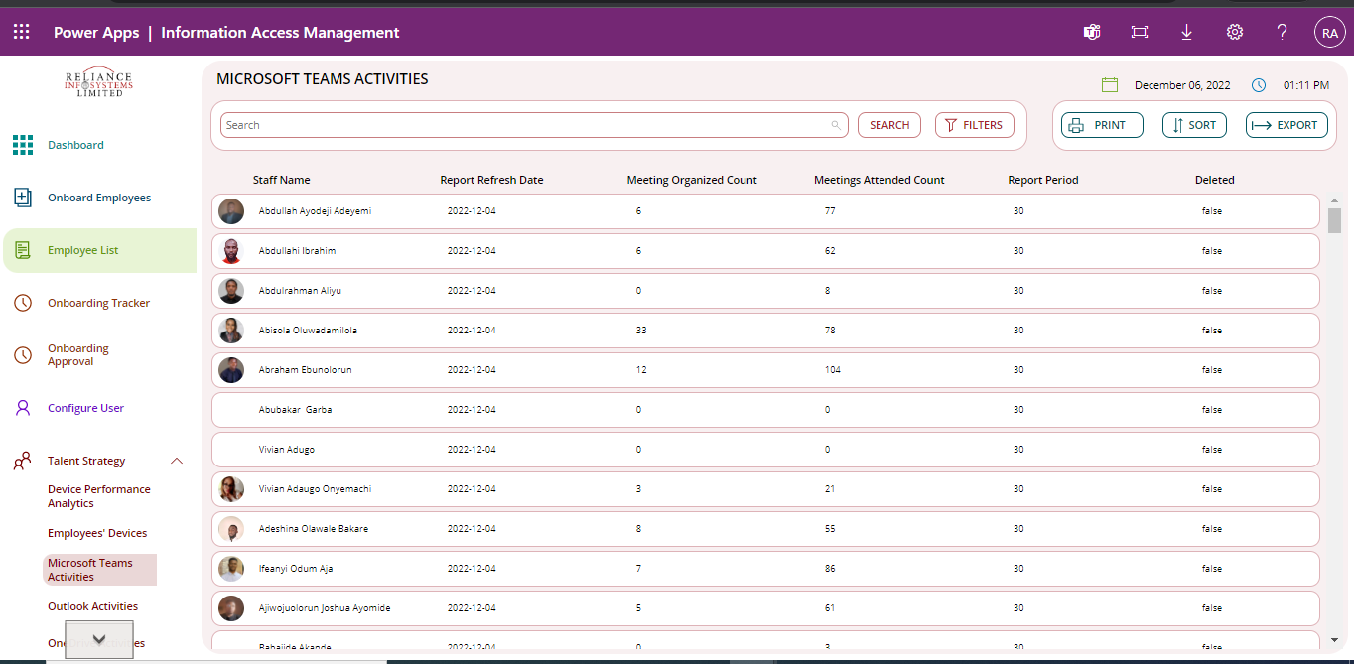
All Doctors
Microsoft Teams Activity
Track employee Teams activity like:
number of organized meetings
Number of meetings attended
Refresh date
Employee productivity and compliance can be tracked from their engagement
Benefits
Evaluate all tasks assigned to help desk agents to implement load balancing
View all tickets that there are in the system to check for trends and patterns
Track all incidents by departments to know when to trigger alternative resolution means.

Slide 14

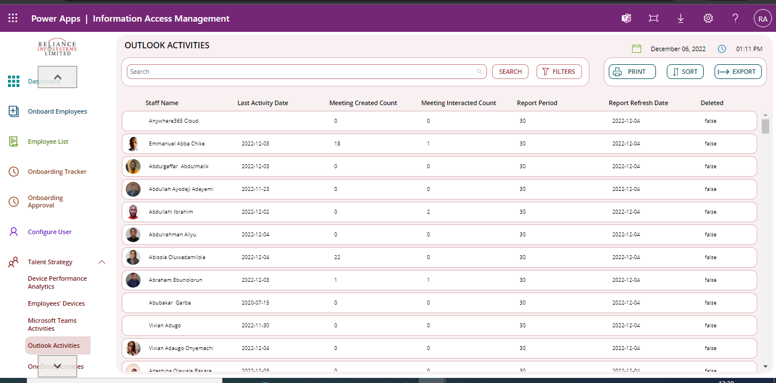
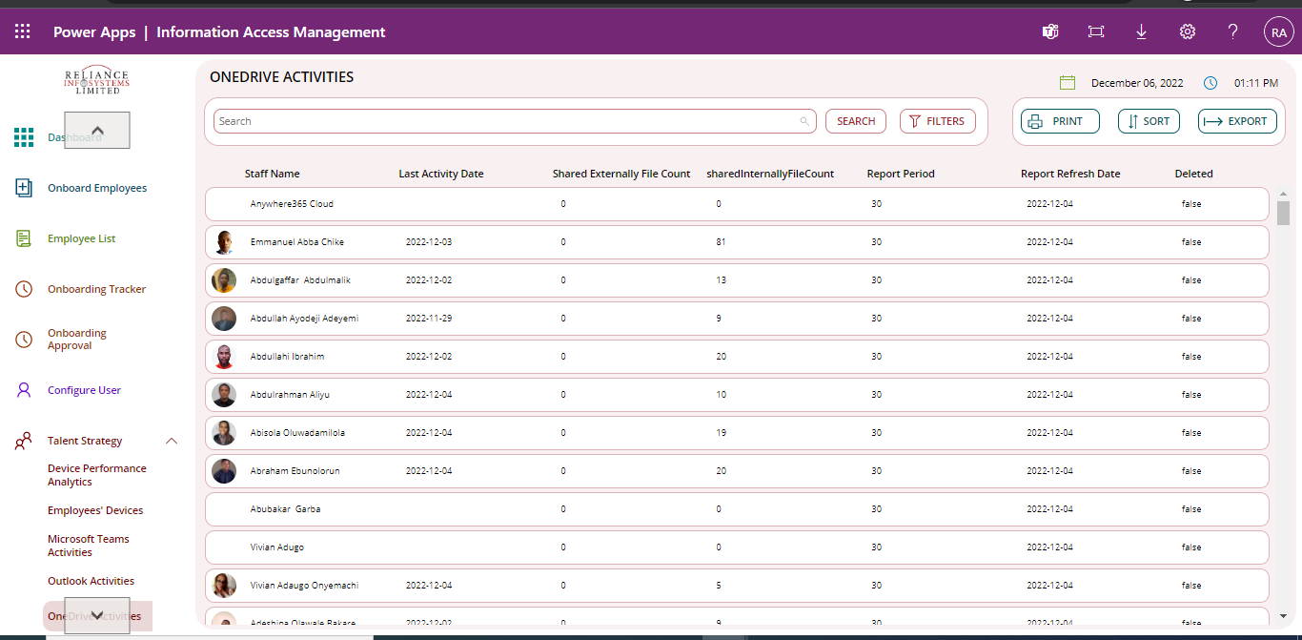
Outlook/OneDrive
Benefits
Track employee’s Outlook and OneDrive activities
Refresh date
Meeting created
Meeting interacted
Documents shared
All this information is part of indices to measure employee productivity and performance

Slide 15
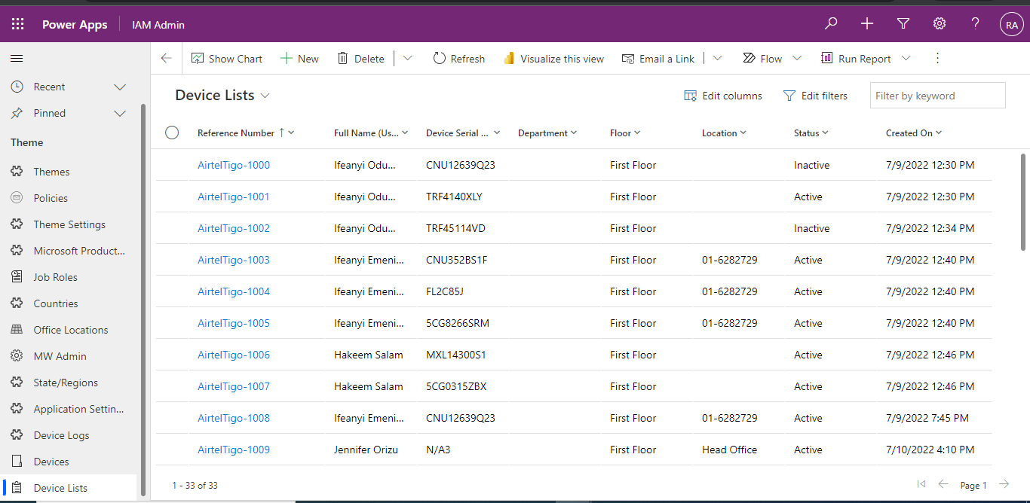
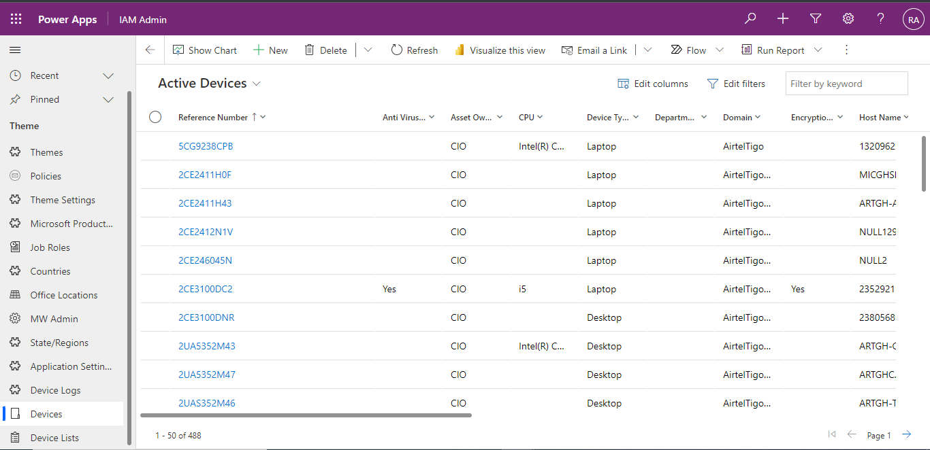
Devices
Benefits
View all devices and assignees
Track active devices and inactive devices
Track device location

Slide 16
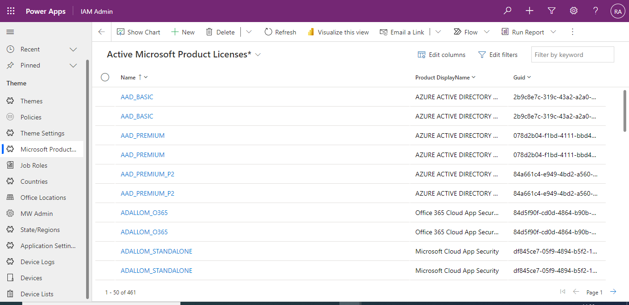
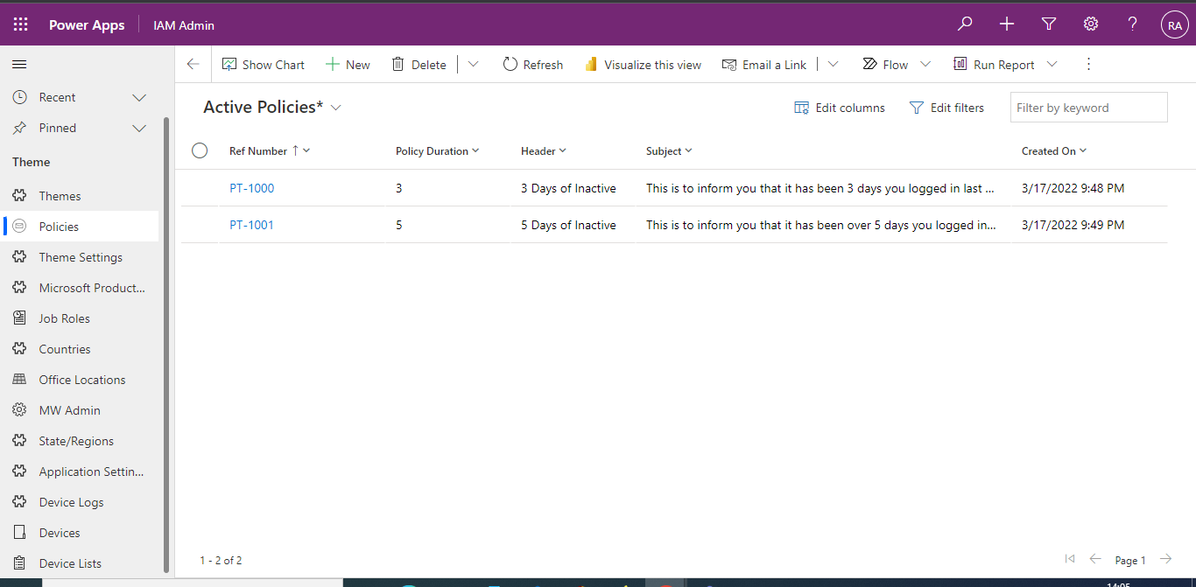
Admin Policies
Benefits
Configure compliance and non compliance requirements according to company policy
Configure all company licenses

Slide 17
Thank You
© Copyright Reliance Infosystems Limited. All rights reserved.

